Slide 1
Smart Rodent Trap

Slide 2
Problem Statement
The goal of the project is to build a humane trap for rodents (rats, squirrels, mice) with remote release.

Slide 3
Constraint
Non Lethal
Prototype must cost less than $400
Must be completed in 10 weeks

Slide 4
Function | Means
Trapping rodent | Trap door (spring loaded)
Enclose rodent | Rectangular prism
Release rodent | Electromagnet controlled door
Alert user of trapped rodent | SMS
Remote control release | Timer button controlling electromagnet and gravity
Stop door from reopening | Door 1: spring and stopper Door 2: mechanical lock
Sense rodent | Mechanical weight sensor

Slide 5
Bill of Materials Free materials supplied by Lab
Part name | Quantity | Function | Dimensions | Cost
Electromagnet | 1 | To keep the trapdoor shut when activated. | 1.25”tall 0.75” diameter 9lb pull force | $44
Fona Arduino | 1 | To send a text to the user and regulate how long the electromagnet is active. Also provides power. |  | $40
Relay | 1 | To close the circuit when the button is pressed. | 5V | $5
Torsion Spring | 1 | To close the door when the rodent steps on the plate | Diameter: 0.29 in Length: 2 in | Custom-made $20

Slide 6
Part name | Quantity | Function | Dimensions | Cost
Breadboard | 1 | Connects all the electrical components together and regulates flow of information | 400 point breadboard | $6
Battery | 1 | Supplies power | 9V | Free
Push Button | 1 | Activates the electromagnet | 12mm^2 | Free
Washer | 1 | Locks the door when attracted to electromagnet |  | Free

Slide 7
Part name | Quantity | Function | Dimensions | Cost
Acrylic Sheets | 2 | Trap encasing | 12”x24” | Free
Joints | 6 | Hold the trap together | 1.5 x 1.5 in | Free
Screws | 12 | Hold the trap together |  | Free
Battery Case | 1 | Holds the battery | 9V Battery Size | Free
Plastic Box | 1 | Encloses the circuits | 7.8”x4.7” | Free
Switch | 1 | Is pressed when door is closed, sends SMS |  | Free
Total Cost: $115

Slide 8
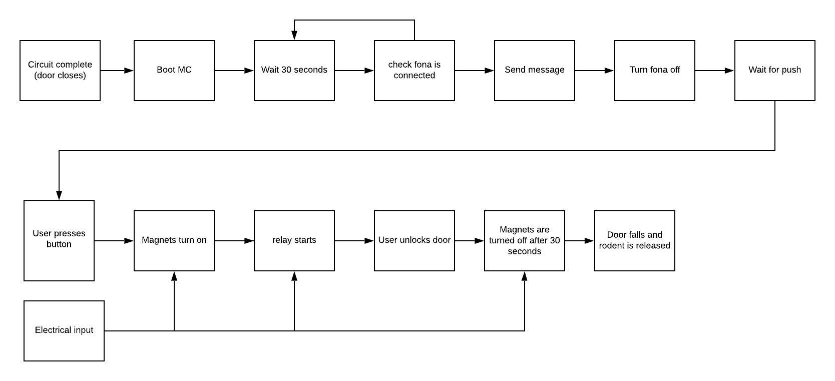
Functional Analysis

Slide 9
Modeling
Battery Usage
9V battery contains 600mA hours
Fona 800 Board to send a text message: Uses 200mA run for 1 minute
Electromagnet to keep backdoor closed: Uses 1000mA run for 30 seconds
With normal usage the battery should last for over 60 catches

Slide 10
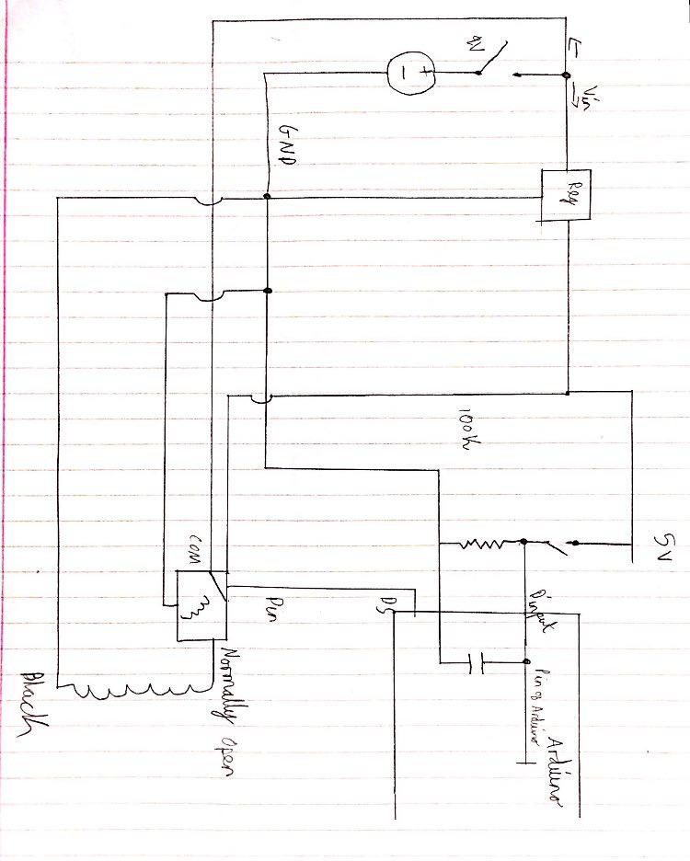
Circuit Diagram

Slide 11
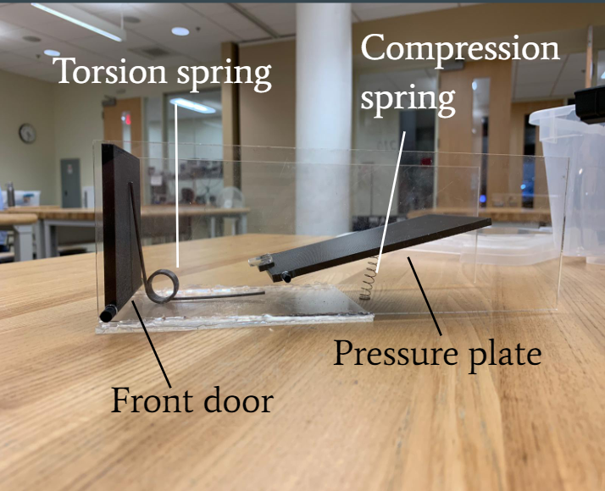
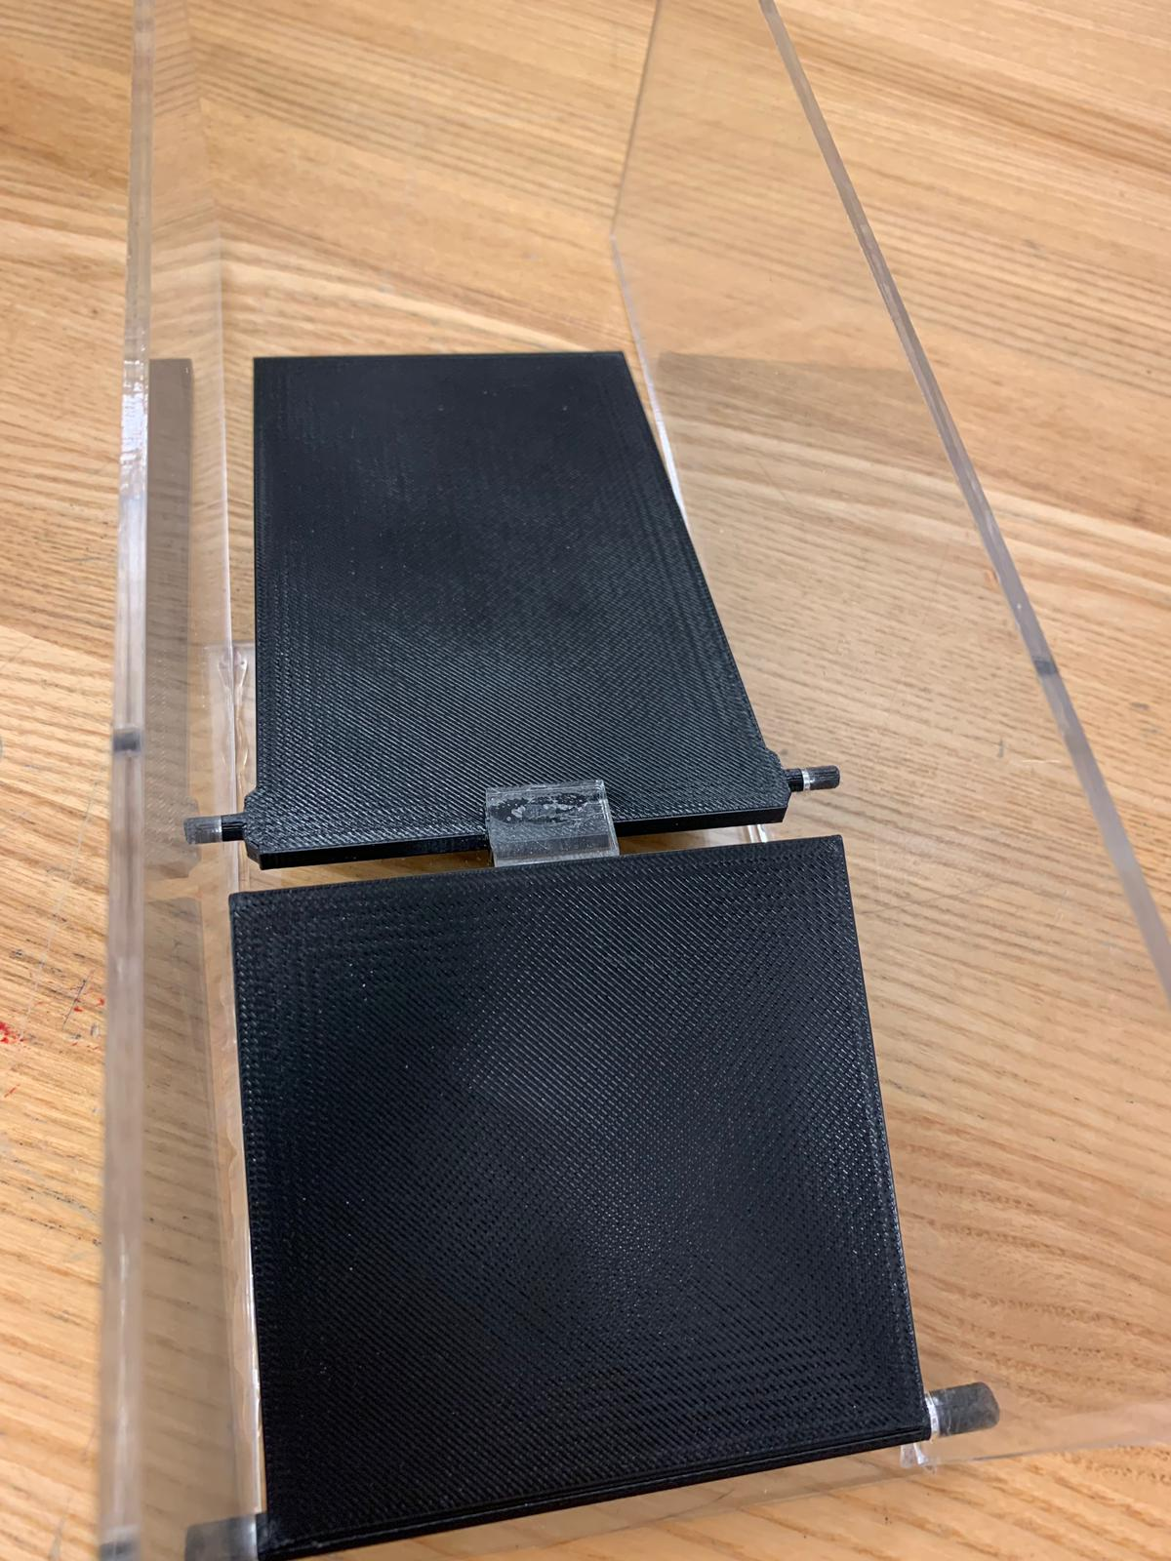

Slide 12
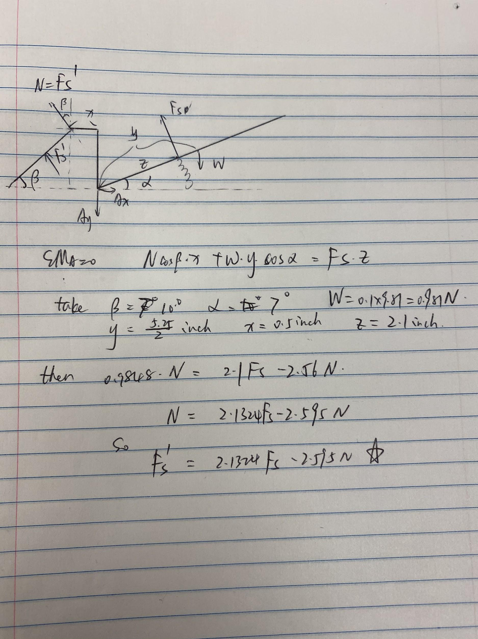

The Relationship Between Our Springs

Slide 13
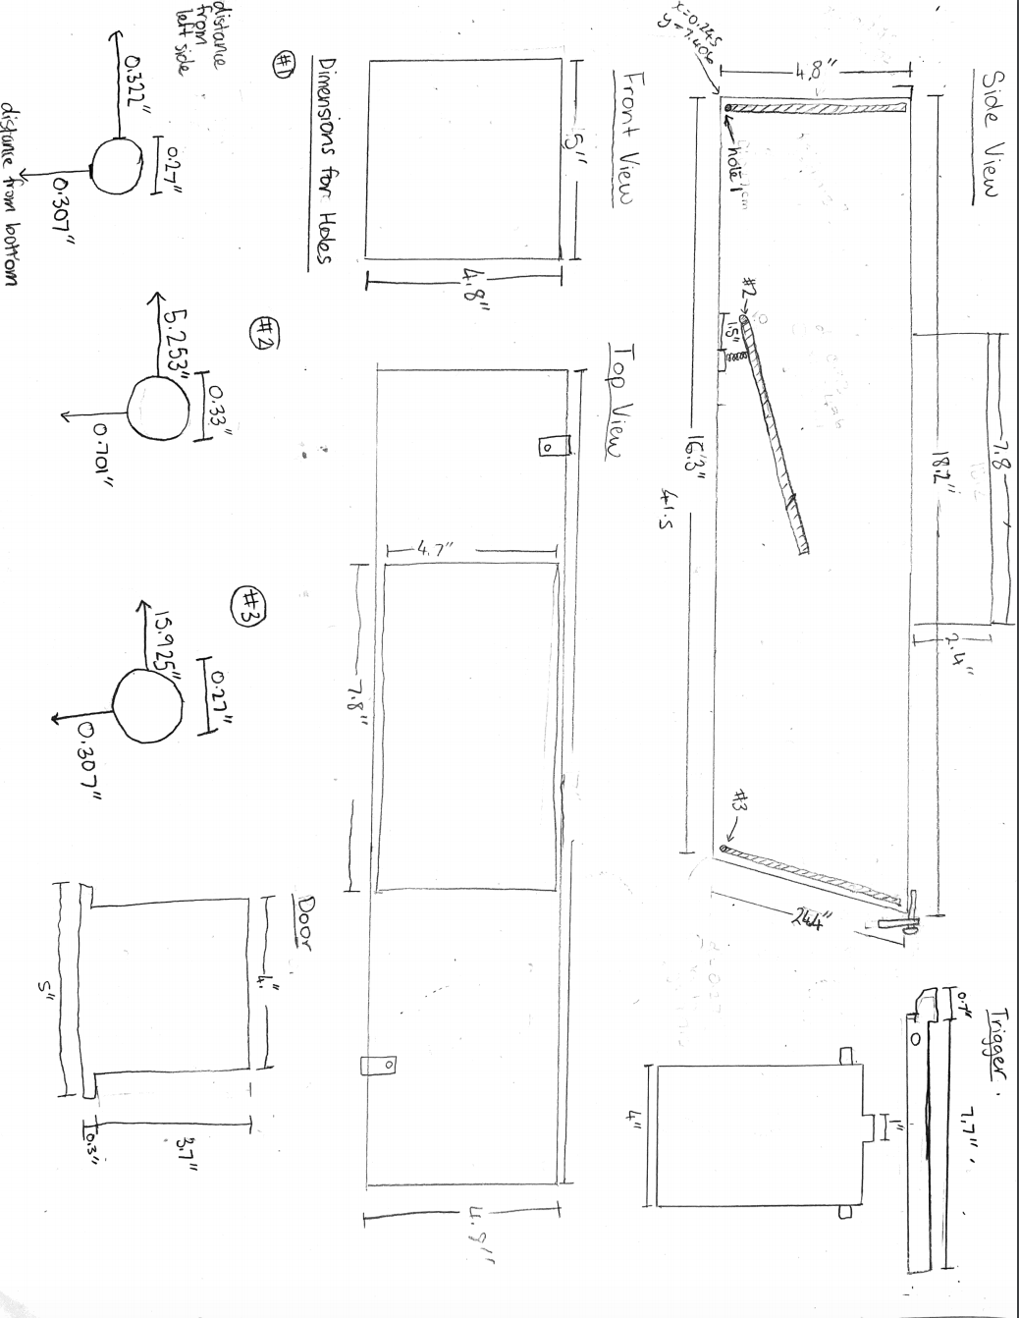
Prototype Specifications

Slide 15
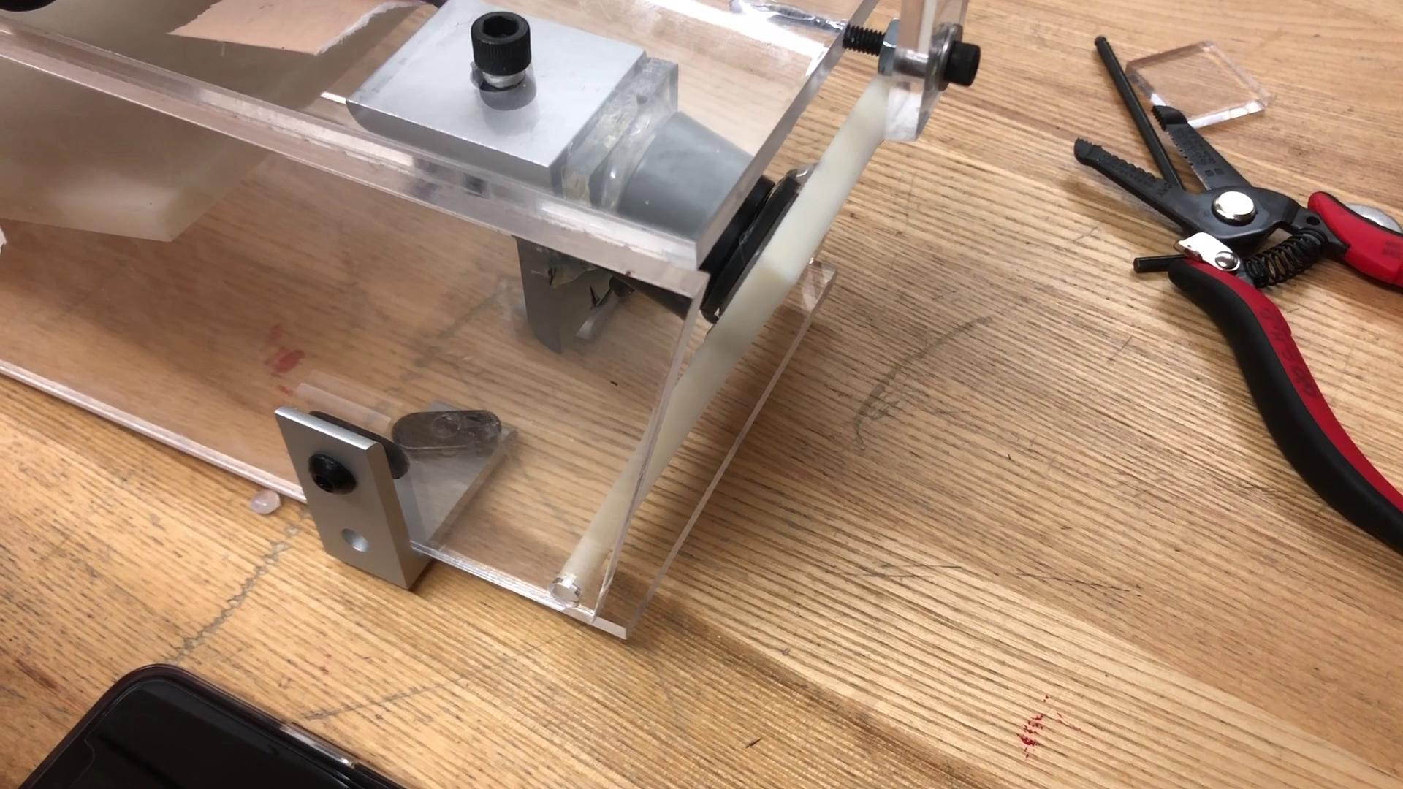
What can we catch?

Slide 16


Slide 17
Objective | Metric
Resistant to weather conditions | Must be able to function in 5˚C - 40˚C temperature conditions
Small | Largest dimension no longer than 22in
Detect when rodent enters | There is at least 4in clearance when rodent inside trap before door closes
Must be able to independently control different traps | Multiple traps can be operated at the same at different stages in the trapping process

Slide 18
Objective | Metric
Batteries must be replaced externally | Uses disposable batteries
Batteries must last for at least a month | Should be able to power trap for 35 trapping events
Notify human or trapped rodent | Human receives notification on their phone via email or text
Remote release of rodent | Person is able to be at least 5m away when trap opens

Slide 19
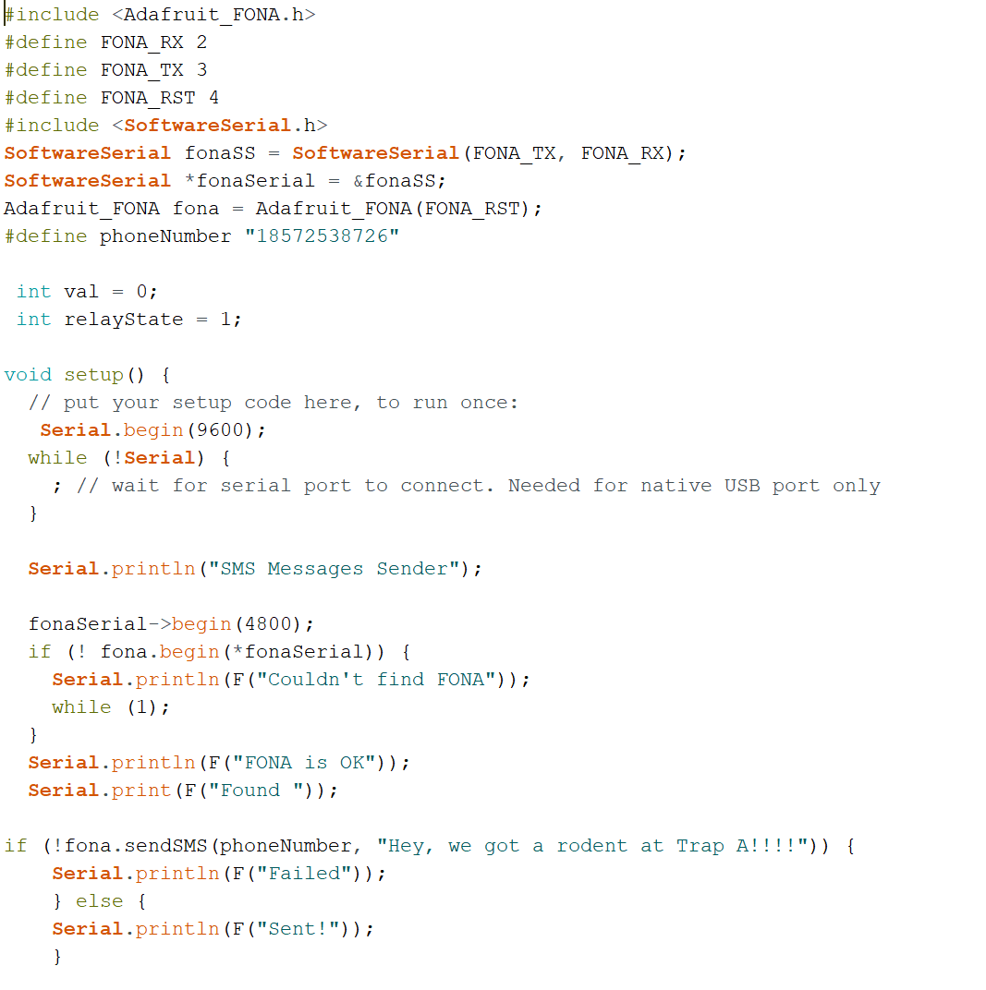
Notify User of Trapped Rodent

Slide 20
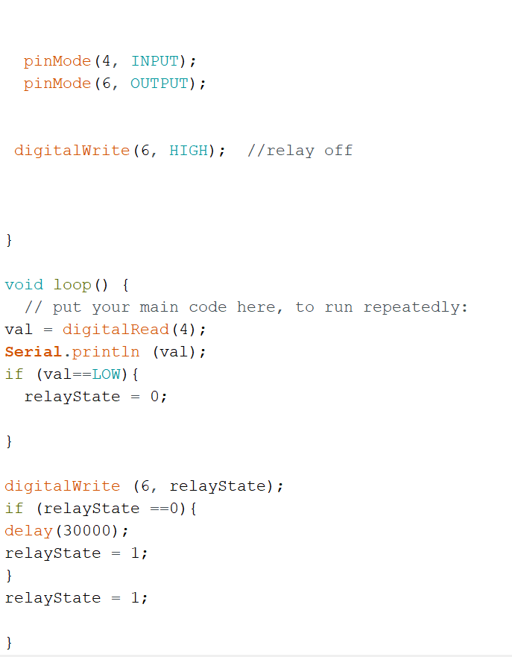
Remotely release

Slide 21
Questions?

